Slide 1
Emerging Business Models: Innovating Partnerships Between Accountable Care Organizations and Pharmacists
Stephanie A. Gernant, PharmD, MS
Assistant Professor of
Pharmacy Practice
Genevieve M. Hale, PharmD, BCPS
Assistant Professor of
Pharmacy Practice
Renee S. Jones, PharmD, CPh
Director of Preceptor Development
Assistant Professor
Tina Joseph, PharmD, BCACP
Assistant Professor of
Pharmacy Practice
Matthew J. Seamon, Pharm.D., Esq.
Chair, Pharmacy Practice
Associate Professor
ACO Research Network, Services and Education
ACORN SEED
Notes:
Thank you Ms. Hendricks for your warm introduction. And thank you Drs. Uzdavines (Uz-davines) and Cerminara (Cher-ME-NADA), Ms. Barbiero (Bar-BI-Ero) and the Nova Law Review Board Members for inviting myself, and my colleagues from the college of pharmacy this afternoon.
This following presentation is in conjunction with NSU’s ACO Research Network, Services and Education Initiative, also known as ACORN SEED. This is a college of pharmacy housed Practice-Based Research network formed just last year with of over 300 primary care providers in Southern Florida.

Slide 2
Notes:
So if you’re a practicing lawyer, raise your hand. If you’re a student, raise your hand. Ok, raise your hand if you didn’t to the last two questions.
It is an honor for me, a pharmacist, to speak to you today, as my profession and your profession are going to need to work collectively to overcome some very critical challenges facing healthcare. Specifically, if you are a lawyer who works for a healthcare system, or a student who is thinking of specializing in healthcare law, you are going to encounter in the very near future issues I’ll be discussing. And there is a huge opportunity, especially if you are student, for you to make a difference in healthcare innovation and regulation of pharmacy practice.
Now, I bet that you don’t think of pharmacy too often, and when pharmacy does come across your discipline as law professionals, it has to do with drug manufacturers or maybe the FDA. Rarely, is anyone ever thinking about what a pharmacist does. Most often, when people do think of pharmaicsts, they think of this guy behind a couple of counters that probably doesn’t even talk to you. He’s counting pills. Maybe he’ll talk to you about your insurance wont’ pay for this or that. But you don’t really think of him as a healthcare provider.
This an antiquated, outdated model, as the pharmacy profession has completely overhauled over the last two decades. Previously, pharmacists used to have limited training, but that is not the case anymore. Now, pharmacists go through 8 years of education, they receive at minimum doctorates in pharmacy, go through 1-2 years of post-graduate residency training, and 1-2 years of fellowship training.
So why am I talking about pharmacists? Why should you care about what they’re doing? I’m going to tell you a three part story of how innovations in pharmacy practice is going to affect you.
The first part is about what the healthcare system is like today,
the second, is what the government has done to try to improve the healthcare system- and how pharmacists fit into that innovation.
and the third, and this is what I need as a pharmacist your legal expertice and help on, is what legal regulations are in place that we are going to have to overcome if our healthcare system is going to utilize medications effectively.
Here’s the first part- Lets talk about the healthcare system as it is today. What’s the leading cause of death? What’s the second? What’s the third?

Slide 3
HEALTHCARE TODAY
ARE THE THIRD
LEADING CAUSE OF DEATH in the US
MEDICAL ERRORS
Motor
Vehicles
34k
Heart Disease
611 k
Suicide
41 k
Firearms
34k
Cancer
585 k
Medical Errors
251 k
COPD
149 k
BMJ Publishing Group Ltd, 2016;
Notes:
The third leading cause of death is medical errors. You’re six times more likely to die from the faulty healthcare system than die from a car crash. The healthcare system is faulty.
What’s the leading cause of medical errors? Medication Errors.
Medical errors are (1) any unintended act (either of omission or commission) or (2) one that does not achieve its intended outcome, (3) the failure of a plan to be completed as intended (an error of execution), the use of a wrong plan to achieve an aim (an error of planning),4 or a deviation from the process of care that may or may not cause harm to the patient.

Slide 4
HEALTHCARE TODAY
MEDICATION ERRORS COST THE US
$20.6 BILLION ANNUALLY
NQF Quality Connections: The Power of Safety, 2010; (5) Yeaw J, J Manag Care Pharm 2009.
Notes:
So a medication errors aren’t just a concern for those who die from them, because they cost us living people nearly 21 billion dollars each year. I can’t even fathom what 21 billion dollars actually looks like. So to put it in perspective, with 21 billion dollars, you could operate all of NASA for a year and a half. And that’s just with the money that we WASTE getting medications wrong.
This is a picture taken by the curiosity rover. It’s amazing that we can send a machine to MARS and snap pictures that look like they were taken in Yosemite, but we can’t get people to swallow their pills on a regular basis.
OK, part one of the story is told, we know that the healthcare system is faulty. And the problem has quite a bit to do with medications.

Slide 5
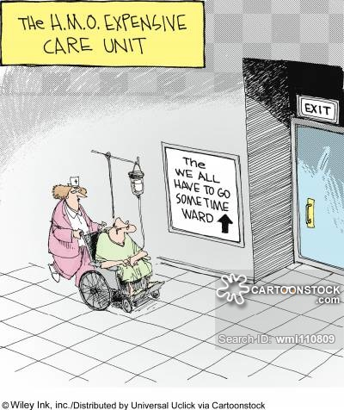
ONCE UPON A TIME…
1980’s: HMO
“Health Maintenance Organization”
Capitation: a lump sum per patient to cover a given set of services
Potentially compromised quality and patient choice
Rizza, C. The history of hmo’s; a chronology of the development of health maintenance organizations. Americans for Free Choice in Medicine. 1995.
Notes:
Part two of our story begins with the US trying to correct the healthcare system. Raise your hand if you were born after 1985. So once upon a time in the late 70’s, we started something called HMO’s or “health maintenance organizations.” These were groups of providers and healthcare systems that were made to keep healthcare costs down.
The HMOs were paid by a model called capitation- not decapitation, but capitation.
Capitation is a method of payment, where a health organization is paid a lump sum of money. The HMO is then responsible for taking care of that patient with the lump sum it was given. This caused several ethical question of how much quality and choice patients would receive. If I am the HMO, then it is in my best interest to spend as little as possible of that money I have on you the patient. The less I spend on the patient, the more I get to keep for myself.
People in general did not like the HMOs, and might rightly have prefer decapitation.

Slide 6
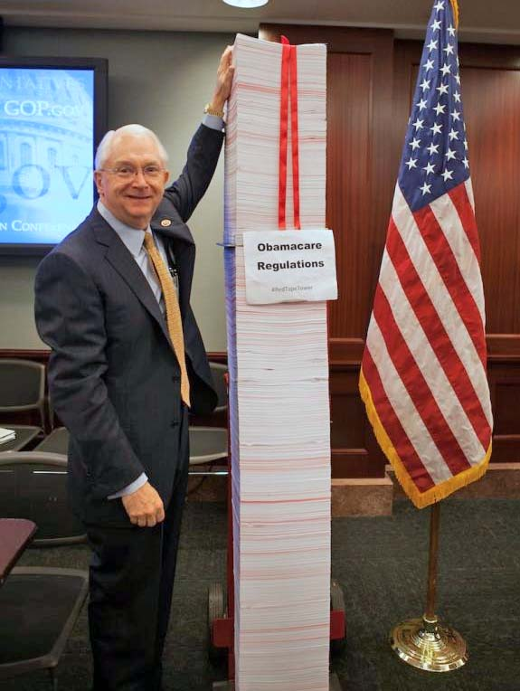
AFFORDABLE CARE ACT
Individual Mandate
Employer Requirements
Tax Related Reform
Health Insurance Exchanges
Focus On Cost Containment While Improving Care
US Department of Health and Human Services. Office of Population Affairs. Affordable care act. 200 Independence Av. S.W. Washington D.C. 20201.
Notes:
So we tried to fix healthcare again. And in 2010 we passed Twenty thousand pages of regulations associated with the affordable care act, also known as the ACA- This was a piece of legislation that was comprehensive healthcare reform. While the ACA did many many thing, including creating more access , establishing tax related reforms and state-run health insurance exchanges, the most notible thing it did was create a payment model called Pay for performance.

Slide 7
ACA CHANGED PAYMENT MODELS
Fee For Service: (aka FFS) healthcare providers are paid for each service
Pay for Performance: (aka: P4P, aka: Value Based Purchasing) financial incentive for achievement of optimal outcomes
Outcomes are called quality measures
HHS wants 90% of Medicare payments on Value Based by 2018
U.S. Department of Health and Human Services. Available from: [http://www.hhs.gov/about/news/2015/01/26/better-smarter-healthier-in-historic-announcement-hhs-sets-clear-goals-and-timeline-for-shifting-medicare-reimbursements-from-volume-to-value.html]
Notes:
The ACA changed how healthcare systems get paid.
The traditional model for healthcare payment is Fee for Service. This is simple and exactly like it sounds. I as a healthcare provider get a fee from you the patient or your insurance for giving you a service. The more services I give, the more money I get. This traditional model is criticized for overspending and providing sub-optimal care.
The ACA created “Pay for Performance” otherwise known as Value Based Purchasing. Value based purchasing provides financial incentives to healthcare systems that are effective and make their patients healthy. Healthcare systems get graded on their patients’ outcomes, and these outcomes are called quality measures.
Now, we must make a caveat. Fee or service makes healthcare systems sound like commission based salesmen, which is not the case, as the healthcare system puts unrealistic demands on providers’ time. And pay for performance sounds like an unfair way to grade doctors, because I certainly have no control over weather you, the patient is going to be compliant with the diet, exercise and medication I gave you.
While initially this may seem unfair, and that providers have no direct control over their patient’s health, this is not the case. In general, CMS incentivizes health care entities to adhere to evidence-based guidelines ( for example, ordering of pneumonia vaccines for all patients over the age of 65, or making sure women get their mammogram done).
Why do you need to know about these payment models? Because the US Centers for Medicare & Medicaid Services (CMS) is the single largest payer for health care in the United States. Nearly 90 million Americans rely on health care benefits through CMS, and by 2018, nearly all of Medicare payments will be on value based systems. Like the third law of thermodynamics, you can not get out of this game.

Slide 8
ACCOUNTABLE CARE ORGANIZATIONS
ACO’s: A group of providers, hospitals, and other healthcare organizations that tie reimbursements to quality indicators and reductions in the total cost of care for an assigned population of patients.
Still capitation or shared savings, but must meet Quality Measures
Note: ACO not necessarily Patient Centered Medical Home (PCMH)
Centers for Medicare and Medicaid Services. CMS.gov. Accountable care organizations. Accessible from: [http://www.cms.gov/Medicare/Medicare-Fee-for-Service-Payment/ACO/index.html?redirect=/aco/]
Notes:
Which brings us to the Accountable Care Organization. Pay for performance took the idea of an HMO, the health maintence organization, and evolved it into something called the ACO- the accountable care organization.
As a 1000 foot view, and simplification, an ACO is like an HMO, in that it is a group of providers or health systems that get together and say, we are going to take care of this group of patients. The better we do it, the more money we’ll save, and the more money we save, we’ll split it up among us. But this time, we have to be accountable for how the patient actually Does. We have to meet quality measures. And notably, an ACO patient is not required to stay in the network.
The ACO may still paid like the HMO, in capitation, is still used for payment, but this time, ACO’s must reach certain quality indicators. Alternatively ACO’s may be paid by sharing in savings they make for CMS.
I’d like to point out, that a Patient centered medical homes are not necessarily ACO’s and vice versa. ACO’s are a group of separately run healthcare entities keeping each other accountable. Patient Centered medical homes are a healthcare entity offering many core primary healthcare services.

Slide 9
ACOs GET GRADED
Quality Measures = 4 Domains= 34 Measures
Patient and Caregiver Experience
Patient Safety
Preventative Health
At Risk Populations
US Department of Health and Human Services. Office of Population Affairs. Affordable care act. 200 Independence Av. S.W. Washington D.C. 20201.
Notes:
What are these quality measures we as an ACO have to meet? Well, as of now, there are 34 of them, and they span over 4 domains.
Patient and caregiver experience- Did you patients feel that you communicate well with them, and that they have access to appointments and specialists?
Patient Safety= remember there’s a NASA and a Half of medication errors and it’s the 3ed leading cause of death. Are the medications you’re prescribing making your patients dizzy and fall and break their hip? Are your patients staying out of the hospital?
Preventative Health, meaning are you giving you paints their vaccines and mammograms and colonoscopies? Are you screening for depression?
And lastly management of at- risk populations. Are your patients with high blood pressure meeting their goals? Are your diabetic patients’ sugars out of control? Are you helping your patients quit smoking?
All in all, are you not only keeping costs down, but more importantly, are you giving good care to your patients?

Slide 10
Patient Safety | ACO #8 Risk Standardized, All Condition Readmissions
 | ACO #35 Skilled Nursing Facility 30-Day All-Cause Readmission Measure
 | ACO #36 All-Cause Unplanned Admissions For Patients With Diabetes
 | ACO #37 All-Cause Unplanned Admissions For Patients With Heart Failure
 | ACO #38 All-Cause Unplanned Admissions For Patients With Multiple Chronic Conditions
 | ACO #9 Ambulatory Sensitive Conditions Admissions For COPD Or Asthma In Older Adults
 | ACO #10 Ambulatory Sensitive Conditions Admissions For Heart Failure
 | ACO #39 Documentation Of Current Medications In The Medical Record
 | ACO #13 Screening For Fall Risk
Preventive Health | ACO #14 Influenza Immunization
 | ACO #15 Pneumococcal Vaccination
 | ACO #16 Adult Weight Screening And Follow
 | ACO #17 Tobacco Use Assessment And Cessation Intervention
 | ACO #18 Depression Screening
 | ACO #19 Colorectal Cancer Screening
 | ACO #20 Mammography Screening
 | ACO #21 Proportion Of Adults Who Had Blood Pressure Screened In Past Two Years
At-Risk Population | ACO #40 Depression Remission At Twelve Months
 | ACO #27 & #41 (Composite) Diabetic Beneficiaries w/ HbA1cC in Poor Control; Diabetic Beneficiaries w/ Eye Exam
 | ACO #28 Percent Of Beneficiaries With Hypertension Whose Blood Pressure < 140/90
 | ACO #30 Percent Of Beneficiaries With Ischemic Vascular Disease Who Use Aspirin Or Other Antithrombotic
 | ACO #31 Beta - Blocker Therapy For Left Ventricular Systolic Dysfunction
 | ACO #33 Ace Inhibitor Or Arb Therapy For Patients With CAD And Diabetes and/or Left Ventricular Systolic Dysfunction
Notes:
These are the quality measures your ACOs are getting graded on, minus the patient experience ones. The ones in green have to do with proper medication use, or pharmacist services.
So it has all come full circle. Your healthcare system isn’t doing too hot, and now if you’re going to work in one, you’ve got to show that you’re doing well with these quality measures. These quality measures have quite a bit to do with medications. So how are you going to improve it? You’re probably going to want to get some medication experts in there. Great! We’re just going to hire some pharmacists and clean it up….
And this brings us to the final part of our story, which is the legal hurdles our two professions are facing.

Slide 11
MEETING QUALITY MEASURES: PHARMACIST SERVICES
Disease State Management – Pharmacists monitor, speak with and evaluate patients with chronic conditions such as diabetes, high blood pressure, high cholesterol, depression, pain or other disease states where optimizing medication therapy is a concern in between physician visits to more closely manage these illnesses
Medication Therapy Management – Pharmacists review patients’ medication profiles, and monitor for adherence, drug interactions, and side effects to ensure the medications’ safe and effective use
Patient Education – Pharmacists speak with patient directly about specific disease states using verbal or written material. They can also teach patients about prevention, administration of devices (like inhalers or insulin) and healthy lifestyle management.
Side Effect/Drug Monitoring – Monitoring and communicating with patients who are on risky therapies on an intensive basis
Notes:
The first hurdle we face is that our providers may not understand what pharmacists do, or why they should be helping your health system.
Pharmacist Provided Services in Ambulatory Care Settings. You’re probably going to have some confused clients over what is within a pharmacists scope of practice. And as you know, that scope is regulated by the state board of pharmacy. But these are some examples of what falls into a pharmacists scope of practice.
The below summarizes services currently provided by NSU College of Pharmacy pharmacists in primary care physician offices who are part of an Accountable Care Organization.
Overall, pharmacists work in collaboration with physicians to optimize a patient’s medication therapy. In summary, pharmacists review patients’ labs, medications, conditions and adherence to make recommendations to the prescriber to improve therapies. Patients who could benefit from these pharmacy services are referred by the prescriber to the pharmacists.

Slide 12
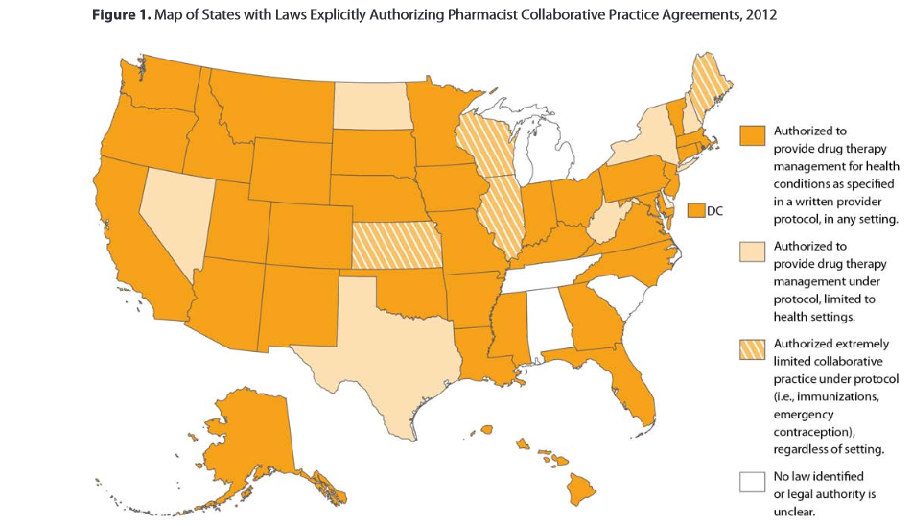
CONCERN: COLLABORATIVE PRACTICE AGREEMENTS
Collaborative Practice Agreement (CPA)
-Legal document between a provider and a pharmacist
Centers for Disease Control and Prevention. Collaborative Practice Agreements and Pharmacists’ Patient Care Services: A Resource for Pharmacists. Atlanta, GA: US Dept. of Health and Human Services, Centers for Disease Control and Prevention; 2013. https://www.cdc.gov/dhdsp/pubs/docs/Translational_Tools_Pharmacists.pdf
Notes:
Next, if you’re going to practice in healthcare law in one of the orange states, you’re going to have to familiarize yourself with something called Collaborative Practice Agreements. Collaborative practice agreements are legal documents used to create formal relationships between pharmacists and physicians or other providers that allow for expanded services the pharmacist can provide to patients.
The licensed provider makes a diagnosis, supervises patient care, and refers patients to a pharmacist under a protocol that allows the pharmacist to perform patient care functions specifically stated under the CPA.
States regulate pharmacists’ patient care services through “scope of practice” laws and related rules, including boards of pharmacy and medicine regulations. Depending on each state’s laws, pharmacists can work with other health care providers through CPAs to provide an array of patient care services
State scope of practice laws can allow for broad, unrestricted CPAs between pharmacists and other providers. To build and strengthen collaborative practices, use simple, understandable terms to describe the patient care services, encourage the various health professional organizations to work together when proposing changes to scope of practice laws. Set up or participate in interprofessional committees to discuss how scope of practice laws can expand the role of team-based care. Talk with local health care providers about entering into CPAs. Talk with payers about using viable business models to support pharmacists’ patient care services. Share appropriate health information with providers through the use of EHRs

Slide 13
CONCERN: HIPAA
“Treatment, Payment, Health Care Operations. A covered entity also may disclose protected health information for the treatment activities of any health care provider…or the health care operations of another covered entity… if both covered entities have or had a relationship with the individual and the protected health information pertains to the relationship.”
What is “Treatment, Payment, Health Care Operations?”
“Treatment is the provision, coordination, or management of health care and related services for an individual by one or more health care providers, including consultation between providers regarding a patient and referral of a patient by one provider to another.”
US Department of Health and Human Services. Office of Civil Rights. Privacy Brief. Summary of the HIPAA Privacy Rule. May, 2003. Accessible from: [http://www.hhs.gov/ocr/privacy/hipaa/understanding/summary/privacysummary.pdf]
Notes:
Here’s the next hurdle you’re going to have to jump. Do you know what HIPAA is? HIPAA is the federal Health Insurance Portability and Accountability Act of 1996. The primary goal of the law is to make it easier for people to keep health insurance, protect the confidentiality and security of healthcare information. Whenever you go to the doctors office and they make you sign the privacy statement, it’s HIPAA that you’re signing for. Your health systems are going to be concerned that they are in violation if they share health information about their patients with pharmacists and pharmacies.
So, a covered entity may disclose protected health information to another covered entity for treatment, payment and health care operations if both covered entities have a relationship with the patient.
It goes on to define treatment as the provision of healthcare from a provider.
http://www.hhs.gov/ocr/privacy/hipaa/understanding/summary/privacysummary.pdf
KNOW THE GIST: If you provide health services under Medicare, have a relationship with the patient, and you provide them with health services, you are covered under HIPAA.
If a provider or any team says, “ I can’t share my electronic health record with the pharmacist because the pharmacist doesn’t take care of the patient, that is wrong.”
Just rem know that in practice, if anybody ever says it’s a violation of HIPPA, and you do in fact have a professional and personal relationship with that patient, it isn’t a violation at all.

Slide 14
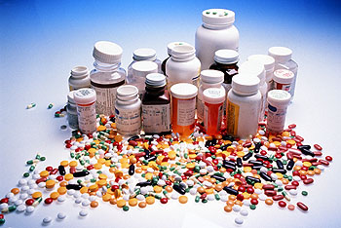
CONCERN: MEDICARE
Notes:
Once you overcome concerns about HIPAA, you’re going to face a lot of billing questions. Medicare is broken up into several parts, named by letters. Part B is the Medicare outpatient benefit. It covers most doctor’s services, durable medical equipment, preventive care, ambulance services, and more. Part D covers prescription drugs. You must have either Part A or Part B to be eligible for Part D. Part D is only available through private companies.
What’s ridiculous is that pharmacist services are not billable through part B. They have to be billed through Part D. but here’s the kicker. Providing services under part D is an expense to these private companies. They MUST offer to provide medication management services. However, the more they give, the most it costs them. When medication management is good, patients take their medications. That means the cost of the medications (part D) goes up. What does that mean for part A and B. When patients are healthy and taking their medications, they don’t have to go to the hospital or utilize the doctor as much. That means that Part D is spending a lot of money to keep the patient taking their medications, but Part A and B reap all the benefits. If I’m a part D provider, I have no incentive whatsoever to get you to take your medications properly, infect, I’m discouraged to give you good care.
You’ve got to know this because when you’re big shot lawyers on capital hill you’ve got to help close this terrible mistake

Slide 15
CONCERN: “PROVIDER STATUS”
The Social Security Act:
Health care providers include all “providers of services” (e.g., institutional providers such as hospitals) and “providers of medical or health services” (e.g., non-institutional providers such as physicians, dentists and other practitioners) as defined by Medicare, and any other person or organization that furnishes, bills, or is paid for health care.
US Department of Health and Human Services. Office of Civil Rights. Privacy Brief. Summary of the HIPAA Privacy Rule. May, 2003. Accessible from: [http://www.hhs.gov/ocr/privacy/hipaa/understanding/summary/privacysummary.pdf]
Notes:
And the only way that this mistake can be remedied is with a change to the US Social Security Act. So only providers specifically named under the Special Security Act can bill Medicare Part B. Pharmacists aren’t one of them.
So here you go. You’re going to work for a health system that is currently wasting billions of dollars in money and killing people by mismanaging medications. The government is telling you that your healthcare systems have to get it right, or else. But they’re not going to let you get paid for the one healthcare professional that has the training and time to fix it.

Slide 16
CONCERN: HEALTH INFORMATION EXCHANGE (HIE)
EHR Incentive Program- Carrot and Stick to integrate Electronic Health Records (EHR)
The eligible professional who transitions their patient to another setting of care or provider of care or refers their patient to another provider of care should provide summary care record for each transition of care or referral.
Eligible Professional Meaningful Use Menu Set Measures Measure 7 of 9. https://www.cms.gov/Regulations-and-Guidance/Legislation/EHRIncentivePrograms/downloads/8_Transition_of_Care_Summary.pdf
Notes:
The U.S. Office of the National Coordinator envisions pharmacies’ involvement in health information exchange (HIE). However, current policy discourages community pharmacists’ engagement in HIE during transitions of care for two major reasons. First, pharmacists are ineligible for reimbursement under CMS’s EHR Incentive Program. This was a program that began in 2011, and it started by giving healthcare providers incentive to turn all their paper records into electronic records (or EHRs). They would give financial incentives to encourage these practices to update. Now, it’s a penalty If you don’t operate on an EHR, so there’s a lot of money that could have been used to update health information exchange between providers and pharmacists, but that window has shut.
Second, concern you’re going to face in trying to get your health system to communicate with pharmacies has to do with a Meaningful use measure under the HER incentive program. Under CMS’ Meaningful Use, health professionals will transmit some medical information during transitions of care to other providers. Transitions of care refers to when a patient moves from one care site to another. Most commonly thought of as a hospital discharge, but could be anything, including a skilled nursing facility, or even just moving primary care providers. Under this ERH incentive meaningful use measure, prescribers must share information concerning a care summary, but this doesn’t get shared to the pharmacy, so you’re going to have patients filling old prescriptions that they shouldn’t be on, and not filling prescriptions that they should be on.

Slide 17
CONCERN: TEAM-BASED CARE AND “INCIDENT-TO-BILLING”
Chronic Care Management (CCM) 99490
For patients with chronic disease at risk of death/exacerbation
Minimum 20 minutes/month
Transitional Care Management Services (TCM) 99495 and 99496
Must have contact within 2 days of discharge
Must coordinate with other healthcare professionals, assess adherence and medication management
US Department of Health and Human Services. Centers for Medicare and Medicaid Services. Medicare Learning Network. Transitional care management services. June, 2013 Accessible from: http://www.cms.gov/Outreach-and-Education/Medicare-Learning-Network-MLN/MLNProducts/Downloads/Transitional-Care-Management-Services-Fact-Sheet-ICN908628.pdf]
Notes:
The last piece of legislation we will see comes from new Billing codes. I’m sure you have heard of CPT codes. These are ways healthcare providers communicate with payers such as Medicare and Medicaid to bill or their services.
Two new set of CPT codes were released, incorporating Care management and Translations Care Management Services. Under Care Management CPT codes, at least 20 minutes of clinical staff time is directed by a physician or other qualified health care professional, per calendar month, with the following required elements: ` Multiple (two or more) chronic conditions expected to last at least 12 months, or until the death of the patient, ` Chronic conditions place the patient at significant risk of death, acute exacerbation/decompensation, or functional decline, ` Comprehensive care plan must be established, implemented, revised, or monitored. These can be done over the phone.
For Transitions care Management., To bill for these services, a healthcare entity must contact a patient within 2 days of hospital discharge, and must deliver a set group of services, including review of the discharge information, providing patient education and care coordination, and reviewing follow- up tests. What I’d also like you to notice is that to bill for Transitional Care, the healthcare provider must also provide medication management, and assess adherence. Pharmacists are even further discouraged to engage in care coordination as they are not recognized providers under the Social Security Act and therefore ineligible to bill Medicare Transitional Care Management Services’ CPT codes directly. Therefore, medication reconciliation during care coordination is billable by most healthcare providers except pharmacists, who are the medication experts.
CMS has acknowledged that the services of pharmacists may be billed “incident to” those of a physician or other qualified health care professional, such as a nurse practitioner or physician assistant, as long as all of the “incident to” requirements are otherwise met. Thus, a clinical pharmacist could be counted among the clinical staff able to provide CCM services “incident to” the services of the physician or mid-level provider under whose provider number the services will otherwise be billed to Medicare. Medicare does not recognize pharmacists as providers for purposes of billing, so we can not directly bill- this is another reason why pharmacists need provider status under the social security acr.
As a small victory, when first giving this lecture, pharmacists were not listed as eligible providers for these CPT codes. CMS has since clarified the rules, this past November, allows physicians to bill Medicare for unsupervised after-hours services provided by nonphysicians under Medicare’s chronic care management (CCM) and transitional care management (TCM) programs. The person who provides these services incident to a physician’s care need not be a direct employee of the medical practice, according to CMS.
In the past, pharmacists had to be part of a physician practice to coordinate and bill for CCM and TCM. The new incident-to billing rules do not require employment, either as a salaried employee or a leased employee, or as an independent contractor, according to CMS. The rules also do not require physical presence at a physician’s office.
“Now that those barriers have been removed, eventually there may be an opportunity to have some of these services outsourced to a pharmacist, who is not part of a practice,” said Jillanne Schulte, JD, APhA Director of Regulatory Affairs.
Schulte makes it clear, however, that agreements need to be in place before pharmacists can perform and bill for these services under incident-to, and pharmacists will need to take the initiative to create these opportunities for themselves.

